Slide 1
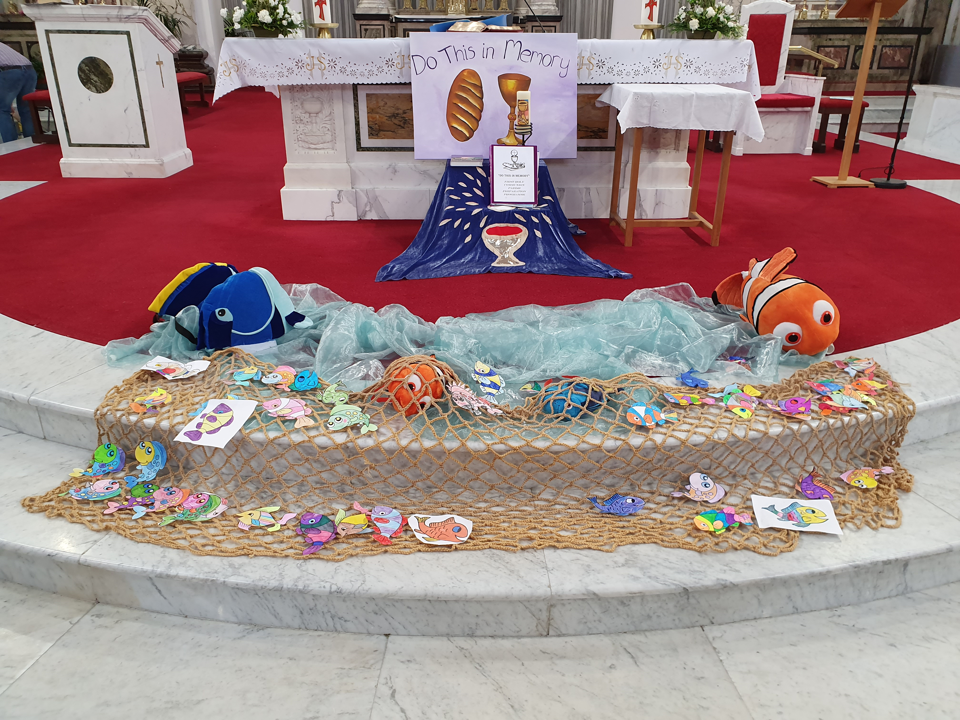
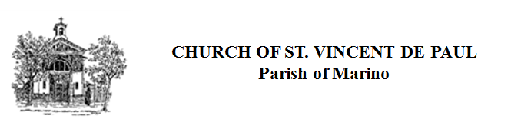
Do this in Memory Mass in preparation for First Communion
26th. January 2020
12.30 Mass
Look at wonderful altar for the Do this in Memory Mass .
The Gospel story was Jesus calling the first of his disciples and promising to have them catch people for his kingdom instead of fish.
All the boys and girls coloured in pictures of fish for the altar display to help them focus on the Gospel story !
Congratulations to all.

